Slide 1
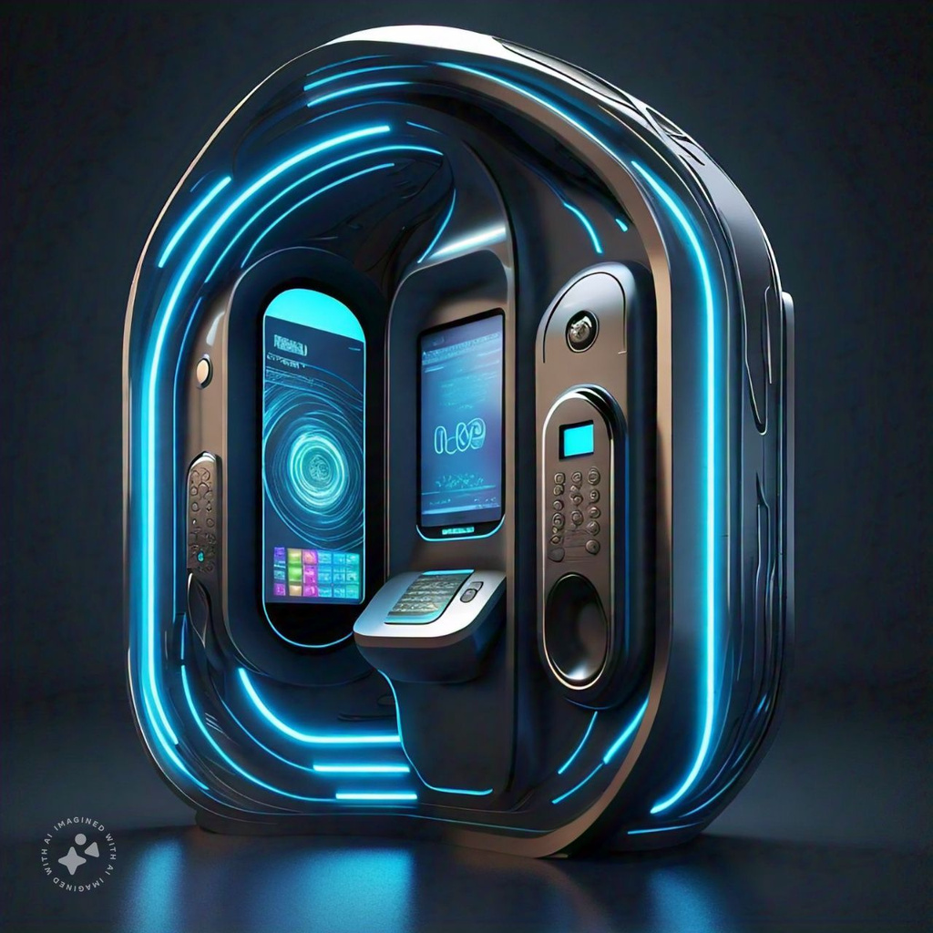
FACE RECOGNTION ATTENDANCE MONITORING
SYSTEM
Group 12
Rishabh Chakraborty 2105817
Saumy 2105825
Ritika Singh 2105819
Harsh Dubey 2105797
Supratim Bhattacharjee 2105839
Soham Patra 2105831

Slide 2
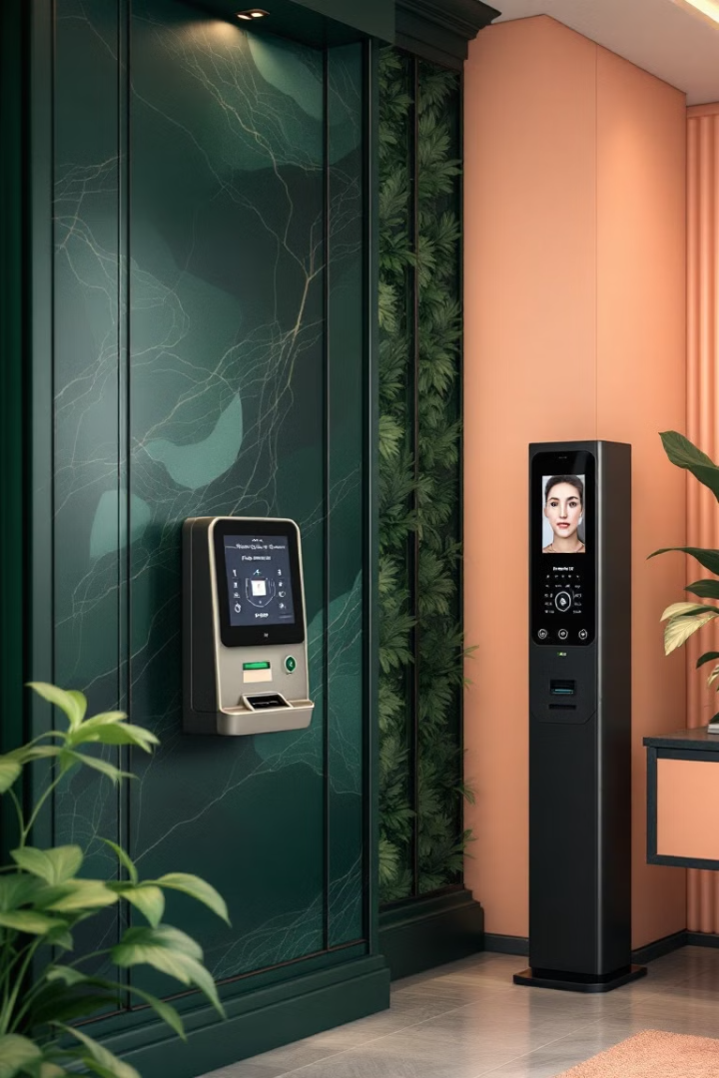
Introduction to Attendance Monitoring
1
Manual Methods
Traditional attendance systems relied on paper sign-in sheets or mechanical time clocks. These methods were prone to errors and time-consuming.
2
Digital Evolution
The advent of digital systems introduced card-based and biometric solutions. These improved accuracy but still had limitations.
3
Face Recognition Era
Modern face recognition technology offers unparalleled accuracy and convenience. It eliminates the need for physical contact or cards.
Notes:
null

Slide 3
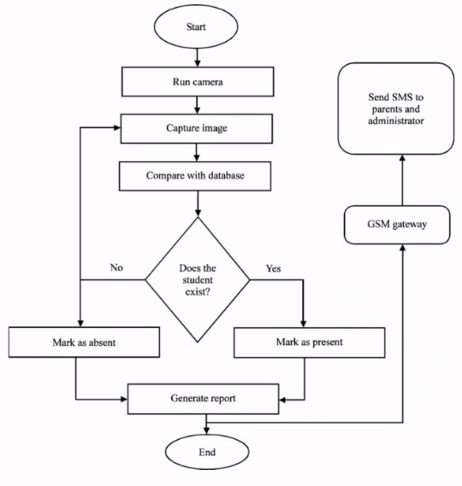




Flow Chart
Image Capture
High-resolution camera captures the individual's face. Multiple angles ensure accurate identification regardless of position.
Feature Extraction
Software analyzes the image and extracts unique facial features. These features are converted into a digital signature.
Database Matching
The digital signature is compared against the database of registered faces. A match confirms the individual's identity.
Attendance Logging
Upon successful identification, the system logs the attendance record. Time, date, and location are recorded in the database.
Notes:
null

Slide 4
System Architecture and Component
Image Acquisition Module
Student
High-definition cameras capture clear facial images. The module optimizes lighting and angle for best results.
Database Server
Secure servers store facial templates and attendance records. They provide fast access for real-time matching and reporting
Logic Details
Attendence Sheet
Web Cam
Face Identification
Web Cam
Processing Unit
Powerful GPUs handle complex computations. They ensure real-time processing of facial recognition algorithms.
Feature Classification
Web Cam
Web Cam
Feature Extraction
User Interface
Intuitive dashboards display attendance data. Administrators can easily manage records and generate reports.
Capture Images
Detect Faces
Training Set

Slide 5
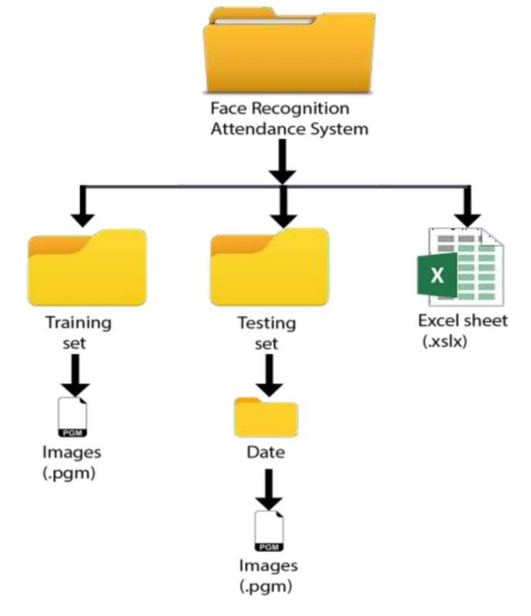
Database Diagram
Table Name
Primary Key
Foreign Key
Students
StudentID
-
FacialFeatures
FeatureID
StudentID
AttendanceRecords
RecordID
StudentID, CourseID
Courses
CourseID
-
Notes:
null

Slide 6
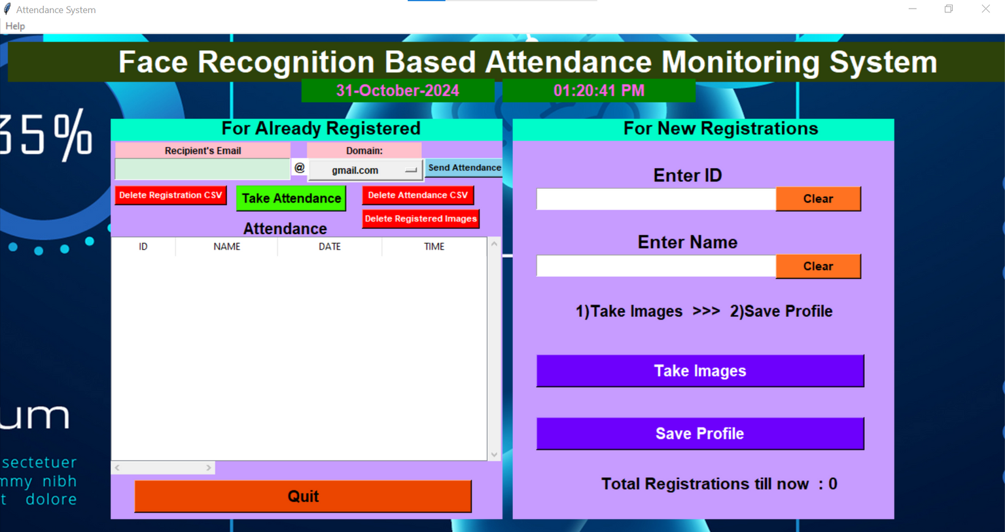
User Interface
Dashboard
Real-time attendance statistics and analytics. Customizable widgets for quick insights and decision-making.
Student Management
Easy-to-use interface for adding and managing student profiles. Bulk upload feature for efficient data entry.
Reports Generator
Flexible reporting tools with various export options. Customizable templates for different stakeholder needs.
Notes:
null

Slide 7
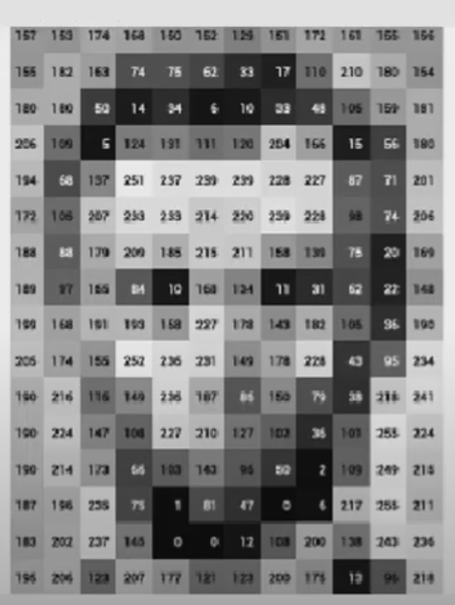
LBPH Algorithm
1
Local Binary Patterns
2
Histogram Creation
Analyzes pixel neighborhoods to create texture patterns. Robust against variations in lighting and facial expressions.
Generates histograms from LBP patterns. Provides compact representation of facial features.
3
Feature Comparison
Compares histograms for face recognition. Uses distance metrics to determine similarity between faces.
Notes:
null

Slide 8
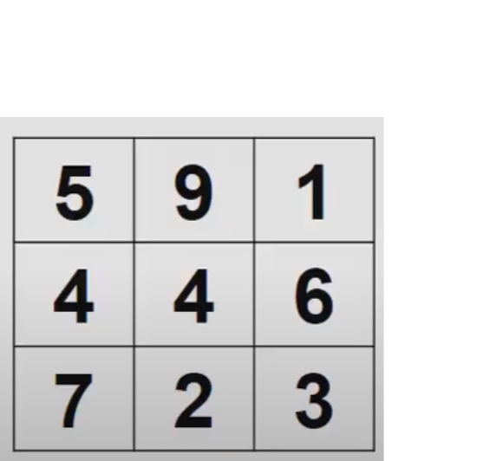

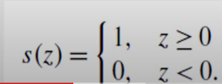


How LBPH Works??

Slide 9
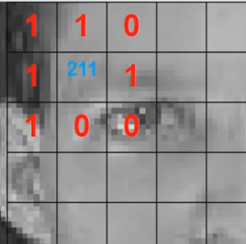
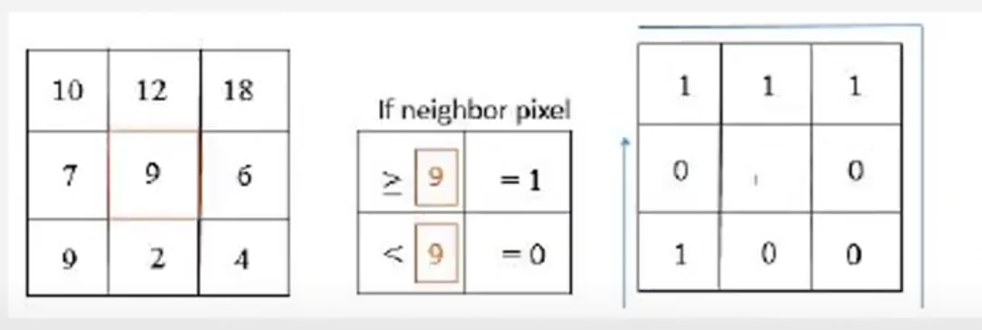
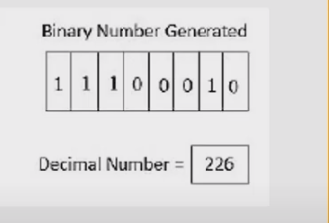
Working Procedure of LBPH Algorithm
= 1 * 2^7 + 1* 2 ^ 6 + 1 * 2^5 + 1 *2^1
= 128 + 64 + 32 +2
= 226

Slide 10
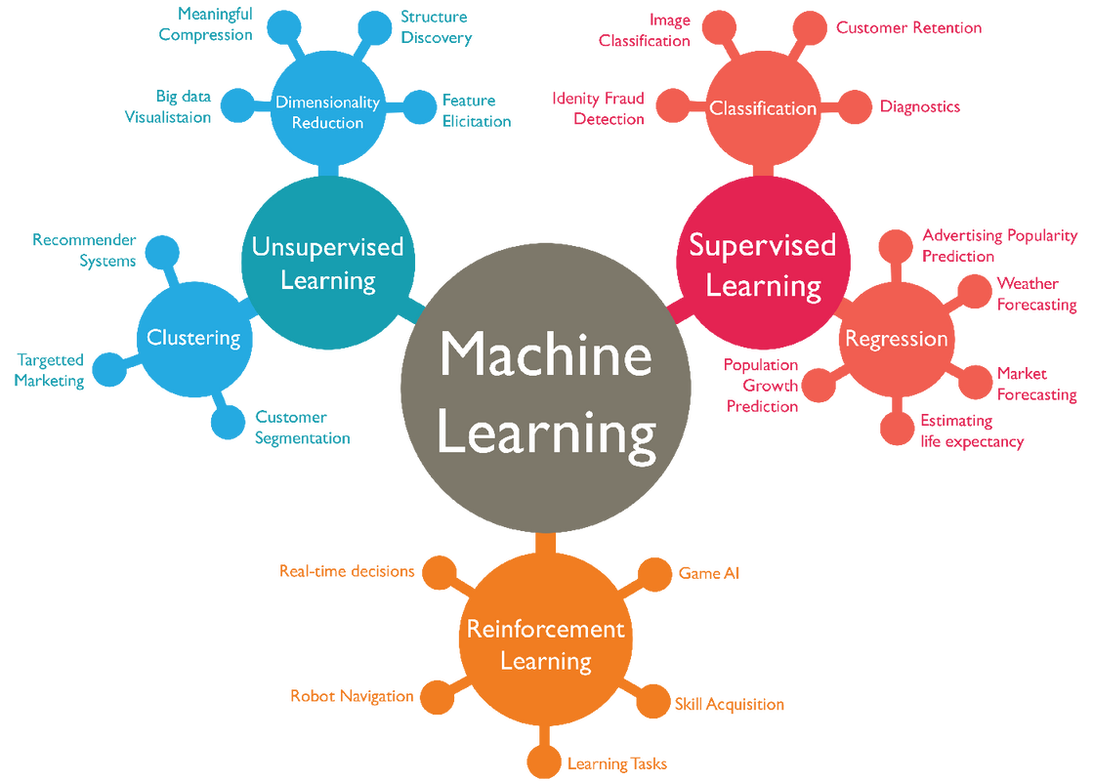
Training the Algorithm
Data Gathering
Collect a diverse dataset of employee facial images for training the recognition model.
Model Selection
Choose an appropriate machine learning
algorithm, such as Local Binary Patterns (LBP)
to train the face recognition model.
Model Training
Use the gathered dataset to train the selected algorithm to accurately identify employees.
Notes:
null

Slide 11
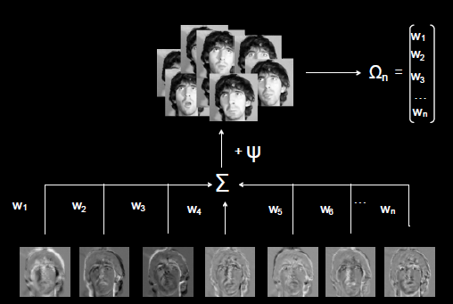
EigenFaces Algorithm
a computer science method for recognizing faces by extracting and representing a person's most important facial features.
Notes:
null

Slide 12
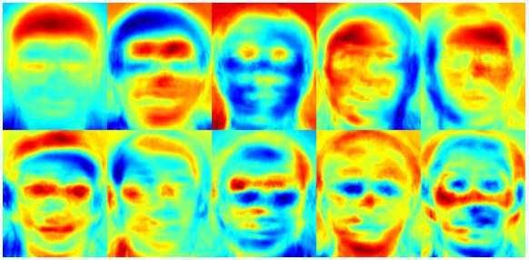
Fisher faces Algorithm
uses Principal Component Analysis (PCA) and Linear Discriminant Analysis (LDA) to reduce the dimension of face space and extract image features
Notes:
null

Slide 13
Comparison From Other Algorithm
Feature | Eigenfaces | Fisher faces | LBPH
Robustness to Lighting | Poor | Moderate | Excellent
Handling Expressions | Limited | Moderate | Excellent
Computational Efficiency | High | Moderate | High
Ease of Implementation | Moderate | Complex | Easy
Training Requirements | High | Moderate | Minimal
Accuracy | Good | Better | Excellent
Overall Suitability | Limited | Good | Excellent
Notes:
null

Slide 14




ACCURACY AND ERROR PREDICTION
Notes:
null

Slide 15
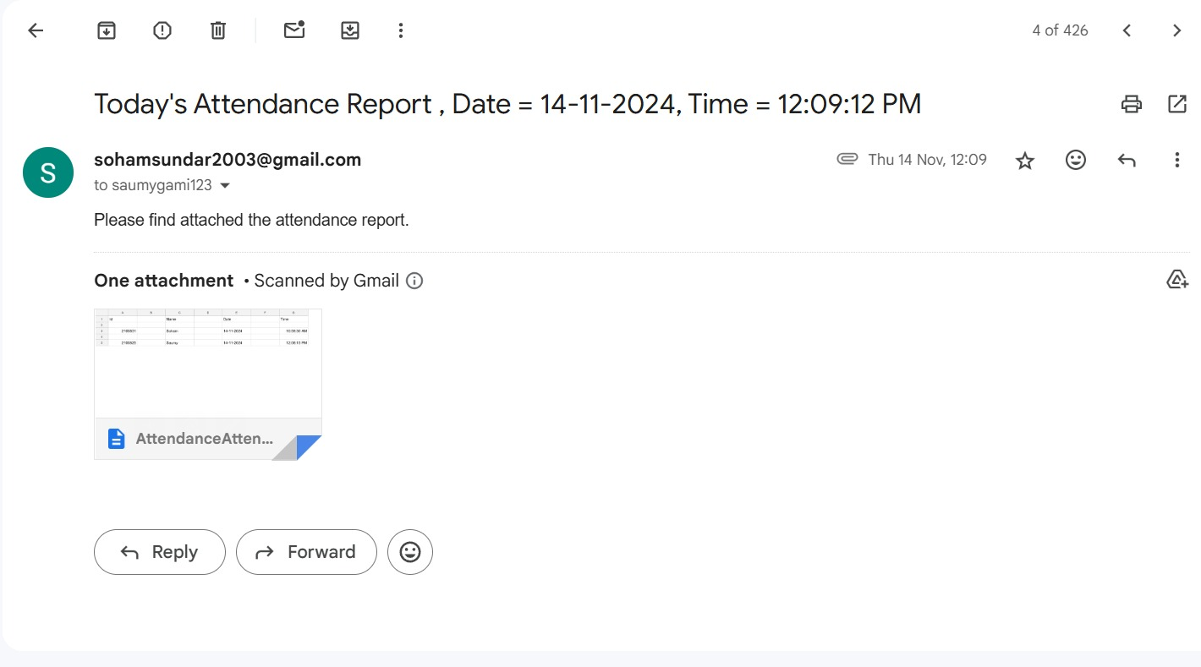
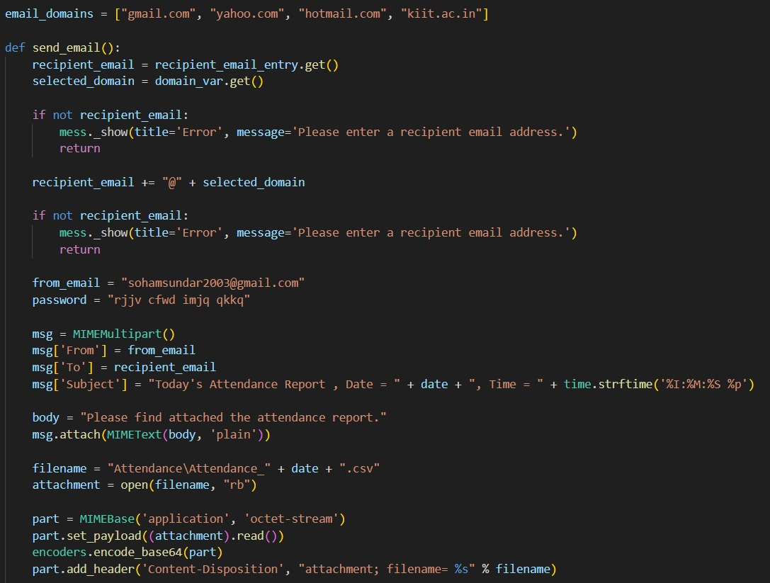
t
Email System
After getting attendance report can be sent to the required email ID of the recipient with proper doc file stating Date and Time
Notes:
null

Slide 16
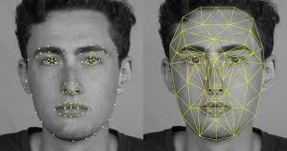
t
FUTURE SCOPE
Contactless Verification (Post-COVID Trend)
Enhanced Security and Spoofing Prevention
Government and Enterprise Adoption
Notes:
null

Slide 17


Conclusion
The face recognition-based attendance monitoring system provides a robust and efficient solution for tracking employee attendance. By leveraging the power of machine learning and biometric identification, this system delivers a secure and convenient way to manage workplace attendance.
Notes:
null

Slide 18

Notes:
null

